Slide 1
CST-111 Introduction to Computer Science and Information Technology Topic 7, Session 1
Notes:
Find four textbook examples to use as student activities, set aside time for students to do assignment; consider check sheet to reduce grading.

Slide 2
Start Recording
Please spin up your VM
Attendance

Slide 3
Dear God,
Please enlighten what is dark in me, strengthen what is weak in me, mend what is broken in me, heal what is sick in me, and revive whatever peace and love has died in me. This is my prayer for me, my family, friends, enemies, and even those who hate me.
Amen
fb.com/LessonsTaughtByLife (modified)
https://www.pinterest.com/pin/501307002277165351

Slide 4
Technology Announcements
December 1st, 2020

Slide 5


Slide 6
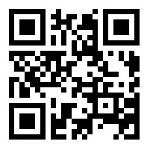
Join Now- IxT
https://www.remind.com/join/gcutech

Slide 7


Cyber Center of Excellence Now Open!
Hours: Monday - Friday
8:30am – 3:30pm
Virtual CyberSaturdays
Professor pre-chat @ 9:30am
Workshop from 10am-12pm
Dates: Dec 5th & Jan 9th
Sign up here
Social Distancing Standards:
Max visitor capacity: 19 individuals
Pre-arranged seating to comply with new standards
No mask, no entry
Notes:
Homeland security?

Slide 8


Slide 9


Slide 10


Slide 11


Slide 12
THIS WEEK
Women's basketball: vs. Loyola Marymount, 1 p.m. Saturday, GCU Arena (students only). GCUTV
NEXT WEEK
Lope Shops 5 Days of Christmas Sale: Monday, 25% off T-shirts; Tuesday, 25% off long-sleeve shirts; Wednesday, 25% off crewnecks; Thursday, 25% off hoodies; Friday, 50% off sidewalk sale. Website
Chapel: Christmas service, 11:15 a.m. Monday, GCU Arena GCUTV
CityServe: 1:30-5 p.m. Wednesday, 27th Avenue complex. In partnership with CityServe US and the Farmers to Families Food Box Program, GCU will be distributing food boxes to families experiencing food insecurity.
Women's basketball: vs. Northern Arizona, 6 p.m. Wednesday, GCU Arena (students only) GCUTV
Men's basketball: vs. Nevada, 7 p.m. Friday, Dec. 11, GCU Arena (students only). Radio: 99.3 and 95.9 FM, 1580 AM. TV: FOX 10 Xtra. GCUTV
Men's basketball: vs. Arizona State, 6 p.m. Sunday, Dec. 13, GCU Arena (students only). Radio: 99.3 and 95.9 FM, 1580 AM. TV: FOX 10 Xtra. GCUTV

Slide 13
Topic 7: Data Security and Bionic Code
Security isn’t just an IT or even a data-related topic anymore. Often we see new technologies released that lack fundamental (and vital) security elements that under any other circumstance would be common sense. (Bluetooth-enabled door locks?)
Objectives:
Identify security risks pertaining to both latent and in-transit data.
Use shared key encryption for both originator authentication and private communication.
Demonstrate robust, efficient, secure, and elegant coding methods
Present all of the code learned during this course.
Manipulate data algorithms to include interleaved hidden data.

Slide 14
Study Materials
Read Chapters 12, 16 and 17 in Introduction to Computing and Programming in Python: A Multimedia Approach

Slide 15
Tasks--Python/IT: Steganography - Multi-Variate Encoding
Description:
The purpose of this assignment is to demonstrate steganographic encryption using Python.
Due Date: 11-April 2021 at 11:59:59 PM
Maximum Points: 55.0
Submit the following in compressed, zip file format:
Your Python program. Naming convention is: firstInitial+lastName+Collage.py. Example: dharalson Collage.py
At least one screen capture demonstrating that your program was functional.
Zip file naming convention is: firstInitial+lastName+collage.zip

Slide 16
Tasks--Python: Collage - Looping Arrays, Basic Debugging
Locate and obtain the collaged photo from Topic 6.
Encrypt the simple text message "Gotcha!" into the photo.
Use the completed collage photo from Topic 6.
Generate a secret text message.
Use Python to create and implement a steganography algorithm that will embed the message within the collage photo.
Within the same code, prompt the user to encode or decode the steganography algorithm and provide the decode functionality to match.

Slide 17
Tasks—Web Showcase
Use your webserver and newPost.py to generate a new post for this week’s programming assignment. Create a (5‐word max) title that describes the nature of the referenced assignment. Include a one sentence description. Use the appropriate *.zip file as your uploaded (and linked) file.
Zip your entire wwwroot folder and submit the zipped file in the following format: firstInitialLastNameWebShowcase.zip. Example: dharalsonWebShowcase.zip If your zip file is too large to submit into LoudCloud, use a cloud storage solution (Dropbox, Microsoft OneDrive, Google Drive) to upload your file, and submit its link to LoudCloud.
Due Date: 11-Apr-2021 at 11:59:59 PM
Maximum Points: 30.0

Slide 18
Tasks—Final Project - Web Showcase Journal
Use the blog form created in Topic 4 to add additional entries to your blog database.
From Topic 4 onward, you created the Web Showcase assignments.
Create additional Web Showcase posts for all assignments as necessary.
Update and polish any existing posts.
You may consider removing all existing posts and re-posting for all assignments. This is not required, but may help you in tracking which items have already been posted.
Provide your webserver IP address as part of your submission.
Zip your entire wwwroot folder and submit the zipped file in the following format: firstInitialLastNameWebShowcase.zip. Example: dharalsonWebShowcase.zip If your zip file is too large to submit into LoudCloud, use a cloud storage solution (Dropbox, Microsoft OneDrive, Google Drive) to upload your file, and submit its link to LoudCloud.
Due Date: 18-Apr-2021 at 11:59:59 PM
Maximum Points: 70.0

Slide 19
Tasks--Python: Bionic Code (Faster, Better, Stronger)
Description:
Research what "elegant code" means with a programming context. Revise all your Python assignments from this course to be elegant.
Due Date: 18-Apr-2021 at 11:59:59 PM
Maximum Points: 55.0
Reduce the number of lines of code.
Perform multiple tasks within single lines of code.
Comment applicable lines with your existing code and replace those with more elegant syntax.
Be sure to comment your changes as well.
Make sure the new program loads and executes correctly.
Submit the following in compressed, zip file format:
Your Python program. Naming convention is: firstInitial+lastName+Collage.py. Example: dharalson Collage.py
At least one screen capture demonstrating that your program was functional.
Zip file naming convention is: firstInitial+lastName+collage.zip

Slide 20
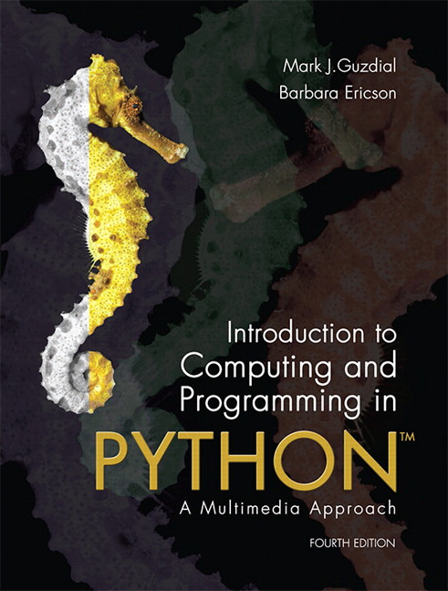
Introduction to Computing and Programming in Python: A Multimedia Approach 4ed
Chapter 12:
Advanced Text Techniques: Web and Information
Notes:
Thanks to John Sanders of Suffolk University for contributions to these slides!

Slide 21
Hiding Text in a Picture
Steganography is hiding information in ways that can’t be easily detected.
One form of steganography is hiding text information of a picture.

Slide 22
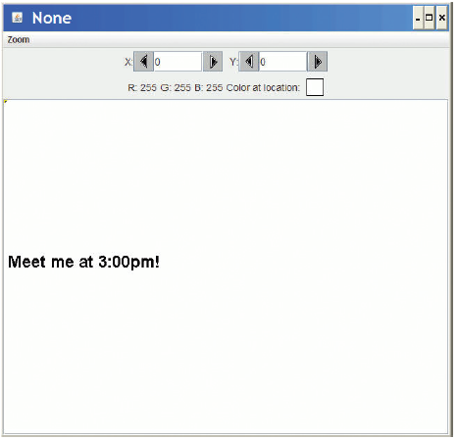
Our Algorithm for Hiding Text
We’ll draw our message in black pixels on a message picture.
We’ll hide our message in a picture of the same size.
First: Make sure that all red values are even.
Second: For every pixel where the message picture is black, add one to the red value at the corresponding x,y.
Notes:
Grand Canyon Photo 1078 x 300

Slide 23
Function to encode the message
def encode(msgPic ,original ):
# Assume msgPic and original have same dimensions
# First , make all red pixels even
for pxl in getPixels(original ):
# Using modulo operator to test oddness
if (getRed(pxl) % 2) == 1:
setRed(pxl , getRed(pxl) - 1)
# Second , wherever there ’s black in msgPic
# make odd the red in the corresponding original pixel
for x in range(0, getWidth(original )):
for y in range(0, getHeight(original )):
msgPxl = getPixel(msgPic ,x,y)
origPxl = getPixel(original ,x,y)
if (distance(getColor(msgPxl),black) < 100.0):
# It’s a message pixel! Make the red value odd.
setRed(origPxl , getRed(origPxl )+1)

Slide 24

Doing the encoding
>>> beach = makePicture(getMediaPath("beach.jpg"))
>>> explore(beach)
>>> msg = makePicture(getMediaPath("msg.jpg"))
>>> encode(msg,beach)
>>> explore(beach)
>>> writePictureTo(beach,getMediaPath("beachHidden.png"))
It’s really important to save the message as .PNG or .BMP, not JPEG. JPEG is lossy so pixel color values might change. PNG and BMP are lossless formats.
Original Encoded

Slide 25
Decoding: Getting the message back
Create a new “message” picture of same size as the encoded image.
For each pixel, if the red value is odd, make the pixel in the message at the same x,y black.
def decode(encodedImg):
# Takes in an encoded image. Return the original message
message = makeEmptyPicture(getWidth(encodedImg),getHeight(encodedImg))
for x in range(0,getWidth(encodedImg)):
for y in range(0,getHeight(encodedImg)):
encPxl = getPixel(encodedImg,x,y)
msgPxl = getPixel(message,x,y)
if (getRed(encPxl) % 2) == 1:
setColor(msgPxl,black)
return message

Slide 26
Encoding sound in a picture
def encodeSound(sound,picture):
soundIndex = 0
for p in getPixels(picture):
# Clear out the red LSB
r = getRed(p)
if ((r % 2) == 1):
setRed(p,r-1)
for p in getPixels(picture):
# Did we run out of sound?
if soundIndex == getLength(sound):
break
# Get the sample value
value = getSampleValueAt(sound,soundIndex)
if value > 0:
setRed(p,getRed(p)+1)
soundIndex = soundIndex + 1

Slide 27
Decoding sound from a picture
def decodeSound(picture):
sound = makeEmptySoundBySeconds(5)
sndIndex = 0
for p in getPixels(picture):
# Did we run out of sound?
if sndIndex == getLength(sound):
break
# Is it mostly red, mostly blue, or mostly green?
if ((getRed(p) % 2) == 1):
setSampleValueAt(sound,sndIndex,32000)
else:
setSampleValueAt(sound,sndIndex,-32000)
sndIndex = sndIndex + 1
return(sound)

Slide 28
Introduction to Computing and Programming in Python: A Multimedia Approach
Chapter 16:
Topics in Computer Science: Functional Programming
Notes:
Thanks to John Sanders of Suffolk University for contributions to these slides!

Slide 29
Functions: What's the point?
Why do we have functions?
More specifically, why have more than one?
And if you have more than one, which ones should you have?
Once I have functions, what can I use them for?

Slide 30
Functions are for Managing Complexity
Can we write all our programs as one large function? YES, but it gets HARD!
As programs grow in size, they grow in complexity.
How do you remember the details like inserting <body> and <li> tags?
Put them inside of functions
How do you change the function over time and find the right place to make the changes you want?
If the function performs a specific role, then if you have to change that role, you change that function.
How do you test and debug your program?
You can put print statements in the whole thing, or, you can test individual functions first.

Slide 31
Advantages to using Functions
Hides details so that you can ignore them.
Makes it clear where you should make changes.
If you need to change the title, it's probably in the title() function.
Makes testing easier.
Helps you in writing new programs because you can reuse trusted, useful functions.

Slide 32
Example: Generating a Home Page
def makeHomePage(name, interest):
file=open("homepage.html","wt")
file.write("""<!DOCTYPE HTML">
<html>
<head>
<title>"""+name+"""'s Home Page</title>
</head>
<body>
<h1>Welcome to """+name+"""'s Home Page</h1>
<p>Hi! I am """+name+""". This is my home page!
I am interested in """+interest+"""</p>
</body>
</html>""")
file.close()
def makeHomePage(name, interest):
file=open("homepage.html","wt")
file.write(doctype())
file.write(title(name+"'s Home Page"))
file.write(body("""
<h1>Welcome to """+name+"""'s Home Page</h1>
<p>Hi! I am """+name+""". This is my home page!
I am interested in """+interest+"""</p>"""))
file.close()
def doctype():
return '<!DOCTYPE HTML">'
def title(titlestring):
return "<html><head><title>"+titlestring+"</title></head>"
def body(bodystring):
return "<body>"+bodystring+"</body></html>"
Which one of these is simpler?

Slide 33
Focusing on the part that we would most likely change
def makeHomePage(name, interest):
file=open("homepage.html","wt")
file.write("""<!DOCTYPE html>
<html>
<head>
<title>"""+name+"""'s Home Page</title>
</head>
<body>
<h1>Welcome to """+name+"""'s Home Page</h1>
<p>Hi! I am """+name+""". This is my home page!
I am interested in """+interest+"""</p>
</body>
</html>""")
file.close()
def makeHomePage(name, interest):
file=open("homepage.html","wt")
file.write(doctype())
file.write(title(name+"'s Home Page"))
file.write(body("""
<h1>Welcome to """+name+"""'s Home Page</h1>
<p>Hi! I am """+name+""". This is my home page!
I am interested in """+interest+"""</p>"""))
file.close()
Now which one is simpler?
Simpler to change? Simpler to modify?

Slide 34
Making testing simpler
We can now check the individual pieces, rather than only the whole thing.
If the individual pieces work, it's more likely that the whole thing works.
You still have to make sure that the pieces fit together well (called integration testing), but you already know what the pieces do and if the pieces work.

Slide 35
Example: Testing the pieces
>>> print doctype()
<!DOCTYPE html>
>>> print title("My title string")
<html><head><title>My title string</title></head>
>>> print body("<h1>My heading</h1><p>My paragraph</p>")
<body><h1>My heading</h1><p>My paragraph</p></body></html>

Slide 36
Adding functions makes it simpler if the functions are chosen well
What if we had sub-functions that did smaller pieces of the overall task?
We call that changing the granularity
Is that better or worse?
It's better if it makes the overall program easier to understand and to change.
It's worse if it simply swaps one kind of complexity for another.

Slide 37
Changing the granularity smaller
def doctype():
return '<!DOCTYPE HTML>'
def startHTML():
return '<html>'
def startHead():
return '<head>'
def endHead():
return '</head>'
def heading(level,string):
return "<h"+str(level)+">"+string+"</h"+str(level)+">"
def startBody():
return "<body>"
def paragraph(string):
return "<p>"+string+"</p>"
def title(titlestring):
return "<title>"+titlestring+"</title>"
def endBody():
return "</body>"
def endHTML():
return "</html>"
def makeHomePage(name, interest):
file=open("homepage.html","wt")
file.write(doctype())
file.write(startHTML())
file.write(startHead())
file.write(title(name+"'s Home Page"))
file.write(endHead())
file.write(startBody())
file.write(heading(1, "Welcome to " + name + "'s Home Page") )
myparagraph = paragraph( "Hi! I am " + name + ". This is my home page! I am interested in " + interest + "</p>" )
file.write(myparagraph)
file.write(endBody())
file.write(endHTML())
file.close()

Slide 38
This is easy to test!
>>> print startHTML()
<html>
>>> print endHTML()
</html>
>>> print title("My title")
<title>My title</title>
>>> print paragraph("My paragraph")
<p>My paragraph</p>
>>> print heading(1,"My heading")
<h1>My heading</h1>
>>> print heading(2,"My other heading")
<h2>My other heading</h2>

Slide 39
Your goal with testing functions: Trust
Do you know what the function is supposed to do?
Do you really understand it?
Does it do what you expect it to do?
For whatever input you give it?
Key Idea: Can you now forget about how it works and just assume that it does work?

Slide 40
Changing the granularity larger
def makeHomePage(name, interest):
file=open("homepage.html","wt")
doctype(file)
title(file, name+"'s Home Page")
body(file, """
<h1>Welcome to """+name+"""'s Home Page</h1>
<p>Hi! I am """+name+""". This is my home page!
I am interested in """+interest+"""</p>""")
file.close()
def doctype(file):
file.write('<!DOCTYPE HTML>')
def title(file, titlestring):
file.write("<html><head><title>"+titlestring+"</title></head>")
def body(file, bodystring):
file.write("<body>"+bodystring+"</body></html>")

Slide 41
Tradeoffs in this granularity
Advantages:
Main function is even easier to read.
More details are hidden, e.g., file writing
Disadvantages:
Harder to test.
There are more parameters to the function, so you'll have to create a file to test them.
Then you can't see the result of the test until you check the file.

Slide 42
Using subfunctions to ease testing and complexity
Recall this program
import os
def makeSamplePage(directory):
samplesfile=open(directory+"//samples.html","wt")
samplesfile.write(doctype())
samplesfile.write(title("Samples from "+directory))
# Now, let's make up the string that will be the body.
samples="<h1>Samples from "+directory+" </h1>\n"
for file in os.listdir(directory):
if file.endswith(".jpg"):
samples=samples+"<p>Filename: "+file+"<br />"
samples=samples+'<img src="'+file+'" height="100" width="100"/></p>\n'
samplesfile.write(body(samples))
samplesfile.close()

Slide 43
What's the hard part? That loop body!
Useful heuristic (rule of thumb): If it's hard, break it out into a subfunction so that you can debug and fix that part on its own.
Notes:
Heuristics don't always work, but often do.

Slide 44
Breaking out the loop body
def makeSamplePage(directory):
samplesfile=open(directory+"//samples.html","wt")
samplesfile.write(doctype())
samplesfile.write(title("Samples from "+directory))
# Now, let's make up the string that will be the body.
samples="<h1>Samples from "+directory+" </h1>\n"
for file in os.listdir(directory):
if file.endswith(".jpg"):
samples = samples + fileEntry(file)
samplesfile.write(body(samples))
samplesfile.close()
def fileEntry(file):
samples="<p>Filename: "+file+"<br />"
samples=samples+'<img src="'+file+'" height="100" width="100"/></p>\n'
return samples

Slide 45
Use More Lines, If You Want
def makeSamplePage(directory):
samplesfile=open(directory+"//samples.html","wt")
samplesfile.write(doctype())
samplesfile.write(title("Samples from "+directory))
# Now, let's make up the string that will be the body.
samples="<h1>Samples from "+directory+" </h1>\n"
for file in os.listdir(directory):
if file.endswith(".jpg"):
samples = samples + fileEntry(file)
samplesfile.write(body(samples))
samplesfile.close()
def fileEntry(file):
samples="<p>Filename: "
samples=samples+file
samples=samples+"<br />"
samples=samples+'<img src="'
samples=samples+file
samples=samples+'" height="100" width="100"'
samples=samples+' /></p>\n'
return samples
If it makes the code make more sense to you, do it that way!

Slide 46
Testing it by itself
>>> print fileEntry("barbara.jpg")
<p>Filename: barbara.jpg<br /><img src="barbara.jpg" height="100" width="100" /></p>
>>> print fileEntry("sunset.jpg")
<p>Filename: sunset.jpg<br /><img src="sunset.jpg" height="100" width="100" /></p>

Slide 47
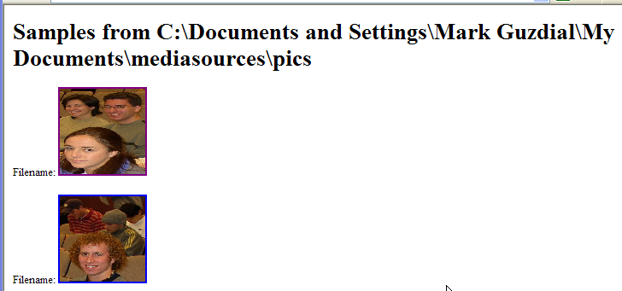
Changing the program: Making the images links
def fileEntry(file):
samples="<p>Filename: "
samples=samples+"<a href="+file+">"
# samples=samples+"<br />"
samples=samples+'<img src="'
samples=samples+file
samples=samples+'" height="100" width="100"'
samples=samples+' /></a></p>\n'
return samples

Slide 48
Testing the links version
>>> print fileEntry("barbara.jpg")
<p>Filename: <a href=barbara.jpg><img src="barbara.jpg" height="100" width="100" /></a></p>
>>> print fileEntry("sunset.jpg")
<p>Filename: <a href=sunset.jpg><img src="sunset.jpg" height="100" width="100" /></a></p>

Slide 49
Changing the program considerably
What if we want to process pictures and sounds separately?
How do we think about that?
We use a process called procedural abstraction

Slide 50
Procedural abstraction
State the problem.
Break the problem into sub-problems.
Keep breaking the sub-problems into smaller problems until you know how to write that chunk.
Goal: Main function is basically telling all the sub-functions what to do.
Each sub-function does one logical task.

Slide 51
What are the problems and sub-problems we're solving now?
Make a samples page
Open an HTML file
Write the DocType
Write the title
Create the body
Write the body and end
Process each JPEG

Slide 52
What we want to change: Processing WAV files, too
Make a samples page
Open an HTML file
Write the DocType
Write the title
Create the body
Write the body and end
Process each JPEG
Process each WAV

Slide 53
Version 1: Not too different
def makeSamplePage(directory):
samplesfile=open(directory+"//samples.html","wt")
samplesfile.write(doctype())
samplesfile.write(title("Samples from "+directory))
# Now, let's make up the string that will be the body.
samples="<h1>Samples from "+directory+" </h1>\n"
for file in os.listdir(directory):
if file.endswith(".jpg"):
samples = samples + fileJPEGEntry(file)
if file.endswith(".wav"):
samples=samples+fileWAVEntry(file)
samplesfile.write(body(samples))
samplesfile.close()
def fileJPEGEntry(file):
samples="<p>Filename: "
samples=samples+"<a href="+file+">"
# samples=samples+"<br />"
samples=samples+'<img src="'
samples=samples+file
samples=samples+'" height="100" width="100"'
samples=samples+' /></a></p>\n'
return samples
def fileWAVEntry(directory, file):
samples="<p>Filename: "
samples=samples+"<a href="+file+">"
# samples=samples+"<br />"
samples=samples+file
samples=smaples+' </a></p>\n'
return samples

Slide 54
What if we computed sizes?
We'll have to pass in the directory
Because now we have to find the actual file
Code gets a little more complicated

Slide 55
Main Function
def makeSamplePage(directory):
samplesfile=open(directory+"//samples.html","wt")
samplesfile.write(doctype())
samplesfile.write(title("Samples from "+directory))
# Now, let's make up the string that will be the body.
samples="<h1>Samples from "+directory+" </h1>\n"
for file in os.listdir(directory):
if file.endswith(".jpg"):
samples = samples + fileJPEGEntry(directory, file)
if file.endswith(".wav"):
samples=samples+fileWAVEntry(directory, file)
samplesfile.write(body(samples))
samplesfile.close()

Slide 56
WAV and JPEG File Entry Functions
def fileJPEGEntry(directory, file):
samples="<p>Filename: "
samples=samples+"<a href="+file+">"
# samples=samples+"<br />"
samples=samples+'<img src="'
samples=samples+file
samples=samples+'" height="100" width="100"'
samples=samples+' /></a>'
pic = makePicture(directory+"//"+file)
samples=samples+" Height: "+str(getHeight(pic))
samples=samples+" Width: "+str(getWidth(pic))
samples=samples+'</p>\n'
return samples
def fileWAVEntry(directory, file):
samples="<p>Filename: "
samples=samples+"<a href="+file+">"
# samples=samples+"<br />"
samples=samples+file
samples=samples+' </a>'
sound=makeSound(directory+"//"+file)
length = getLength(sound) / getSamplingRate(sound)
samples=samples+"Length (seconds): "+str(length)
samples=samples+'</p>\n'
return samples

Slide 57
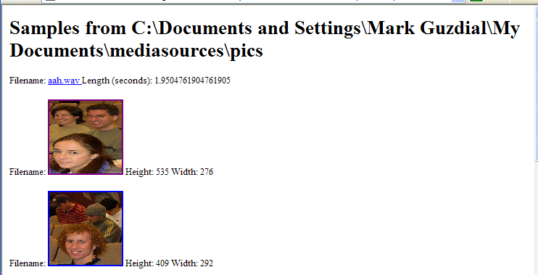
Running the new program

Slide 58
Not really modular
In a modular program (a program that has “good modularity”) each function does one and only one task well.
Look at all the duplicated code in the two file entry functions.
Could we pull that out into yet another function?

Slide 59
Creating a sub-sub-function
Make a samples page
Open an HTML file
Write the DocType
Write the title
Create the body
Write the body and end
Process each JPEG
Process each WAV
Process each entry

Slide 60
Pulling out the sub-sub-function
def fileJPEGEntry(directory, file):
samples=<img src="'
samples=samples+file
samples=samples+'" height="100" width="100"'
samples=samples+' />'
pic = makePicture(directory+"//"+file)
samples=samples+" Height: "+str(getHeight(pic))
samples=samples+" Width: "+str(getWidth(pic))
return fileEntry(samples,file)
def fileWAVEntry(directory, file):
samples=samples+file
samples=samples+' </a>'
sound=makeSound(directory+"//"+file)
length = getLength(sound)/getSamplingRate(sound)
samples=samples+"Length (seconds): "+str(length)
return fileEntry(samples,file)
def fileEntry(filestring,file):
samples="<p>Filename: "
samples=samples+"<a href="+file+">"
samples=samples+filestring
samples=samples+"</a></p>\n"
return samples
fileEntry builds the <a> tag, using an anchor (filestring) and a filename (file).

Slide 61
Can Test Functions Separately
>>> print fileEntry("Here is a file","picture.jpg")
<p>Filename: <a href=picture.jpg>Here is a file</a></p>
>>> print fileWAVEntry(r"C:\Documents and Settings\Mark Guzdial\My Documents\mediasources","aah.wav")
<p>Filename: <a href=aah.wav>aah.wav </a>Length (seconds): 1.9504761904761905</a></p>
>>> print fileJPEGEntry(r"C:\Documents and Settings\Mark Guzdial\My Documents\mediasources","barbara.jpg")
<p>Filename: <a href=barbara.jpg><img src="barbara.jpg" height="100" width="100" /> Height: 294 Width: 222</a></p>

Slide 62
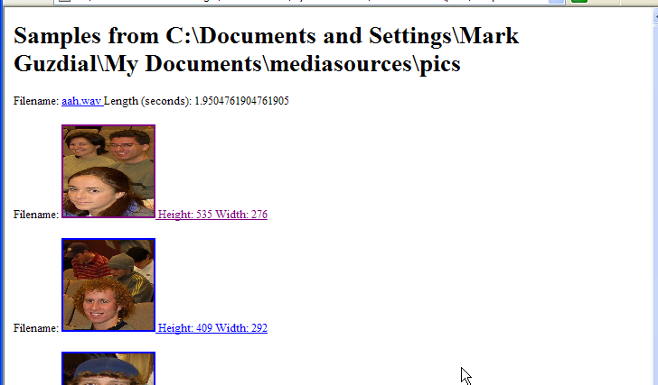
makeSamplePage(r"C:\Documents and Settings\Mark Guzdial\My Documents\mediasources\pics")

Slide 63
Reusability: The reason why professionals value modularity
When a function does one and only one thing, it can easily be reused in new situations.
Consider how we reused the sunset function and the swap background functions in the movie code.
Think about what would have happened if those functions also showed every picture.
They literally couldn't be used to do the movies, because you'd get 100 windows popping up.
Professionals will create a library of their own reusable functions that they'll use in their work.
That's why we have modules and the import statement: To make that kind of library easier to use.

Slide 64
Summary: Why we use functions
Hides details so that you can ignore them.
Makes it clear where you should make changes.
If you need to change the title, it's probably in the title() function.
Makes testing easier.
Helps you in writing new programs because you can reuse trusted, useful functions.

Slide 65
Want to write fewer lines of code?
You can write fewer lines of code and get the same programs written, if you're willing (and able) to trust your functions.
When you really understand functions, you can do all kinds of amazing things in very few lines of code.
Use functions that apply functions to data.
Use recursion: Have functions that call themselves.

Slide 66
Functions are just values associated with names
We call a function by stating its name followed by inputs in parentheses.
Without parentheses, the name of the function still has a value.
It's the function!
Functions are also data.
They can be used as input to other functions!
>>> print makeSamplePage
<function makeSamplePage at 4222078>
>>> print fileEntry
<function fileEntry at 10206598>

Slide 67
Introducing apply
Apply takes a function as input and the inputs to that function in a sequence.
Apply literally applies the function to the input.
def hello(someone):
print "Hello,",someone
>>> hello("Mark")
Hello, Mark
>>> apply(hello,["Mark"])
Hello, Mark
>>> apply(hello,["Betty"])
Hello, Betty

Slide 68
More useful: Map
Map is a function that takes as input a function and a sequence.
But it applies the function to each input in the sequence, and returns whatever the function returns for each.
>>> map(hello, ["Mark","Betty","Matthew","Jenny"])
Hello, Mark
Hello, Betty
Hello, Matthew
Hello, Jenny
[None, None, None, None]

Slide 69
Filter: Returns those for whom the function is true.
Filter also takes a function and a sequence as input.
It applies the function to each element of the sequence.
If the return value of the function is true (1), then filter returns that element.
If the return value of the function is false (0), then filter skips that element.

Slide 70
Filter example
def rname(somename):
if somename.find("r") == -1:
return 0
if somename.find("r") != -1:
return 1
>>> rname("January")
1
>>> rname("July")
0
>>> filter(rname, ["Mark","Betty","Matthew","Jenny"])
['Mark']

Slide 71
We can make rname shorter using a logical operator
An expression like somename.find("r") == -1 actually does evaluate to 0 (false) or 1 (true).
There are operations we can perform on logical values.
Just like + is an operation on numbers and strings.
One of these is not
It creates the opposite of whatever the input value is, true or false.

Slide 72
Making rname shorter
def rname2(somename):
return not(somename.find("r") == -1)
>>> filter(rname2, ["Mark","Betty","Matthew","Jenny"])
['Mark']

Slide 73
Reduce: Combine the results
Reduce takes a function and a sequence, like the others.
But reduce combines the results.
In this example, we total all the numbers by adding 1+2, then (1+2) + 3, then (1+2+3)+4, then (1+2+3+4)+5
def add(a,b):
return a+b
>>> reduce(add,[1,2,3,4,5])
15

Slide 74
Do we really need to define add?
Turns out that we don't even have to give a function a name to be able to use it.
A name-less function is called a lambda
It's an old name, that actually dates back to one of the very oldest programming languages, Lisp.
Wherever you'd use a function name, you can just stick in a lambda
Lambda takes the input variables, colon, and the body of the function (usually just a single line, or else you'd want to name the function.)

Slide 75
Using lambda
>>> reduce(lambda a,b: a+b, [1,2,3,4,5])
15
This does the exact same thing.

Slide 76
Defining factorial with reduce and lambda
def factorial(a):
return reduce(lambda a,b:a*b, range(1,a+1))
>>> factorial(2)
2
>>> factorial(3)
6
>>> factorial(4)
24
>>> factorial(10)
3628800
Remember factorial from math class:
Factorial of n is n*n-1*n-2…*1

Slide 77
Why'd we learn about apply?
Map and filter (as we'll soon see) can really be used to implement real programs.
Why apply?
Because that's how map and filter are implemented!
Given apply, you can roll your own.
def mymap(function,list):
for i in list:
apply(function,[i])
>>> mymap(hello, ["Fred","Barney","Wilma","Betty"])
Hello, Fred
Hello, Barney
Hello, Wilma
Hello, Betty

Slide 78
Interesting…but useful? Yes!
These are really interesting ideas:
Functions are data that can be used as inputs.
We can create functions that manipulate functions.
Meta-functions?
This is functional programming
The style (paradigm) we've been doing so-far is called procedural.
We define processes: Procedures.

Slide 79
Functional Programming
Functional programming is about using layers of functions and functions that apply functions to solve problems.
It's a powerful form of programming, allowing you to do a lot in very few lines of code.
Functional programming is particularly useful in artificial intelligence (AI) research and in building prototypes of systems.
These are both places where the problems are hard and ill-defined, so you want to get as far as possible with as few lines as possible.
Functional programming is also used in large server farms (like Google's), using MapReduce or Hadoop.

Slide 80
Challenge
Look up MapReduce and Hadoop on-line. What are they?

Slide 81
Making turnRed functional
def turnRed():
brown = makeColor(57,16,8)
file = r"C:\Documents and Settings\Mark Guzdial\My Documents\\mediasources\barbara.jpg"
picture=makePicture(file)
for px in getPixels(picture):
color = getColor(px)
if distance(color,brown)<100.0:
redness=getRed(px)*1.5
setRed(px,redness)
show(picture)
return(picture)

Slide 82
Let's make it a functional program
For comparison:
def checkPixel(apixel):
brown = makeColor(57,16,8)
return distance (getColor(apixel),brown)<100.0
def turnRed(apixel):
setRed(apixel,getRed(apixel)*1.5)
def turnRed():
brown = makeColor(57,16,8)
file = r"C:\Documents and Settings\Mark Guzdial\My Documents\\mediasources\barbara.jpg"
picture=makePicture(file)
for px in getPixels(picture):
color = getColor(px)
if distance(color,brown)<100.0:
redness=getRed(px)*1.5
setRed(px,redness)
show(picture)
return(picture)

Slide 83
It's now just a one line program
What we want to do is filter out pixels that match checkPixel, then map the function turnRed to that result.
map(turnRed, filter(checkPixel,getPixels(pic)))

Slide 84
Really using the one-liner
>>> pic=makePicture( getMediaPath("barbara.jpg"))
>>> map(turnRed, filter(checkPixel, getPixels(pic)))

Slide 85
Challenge: One Line
Rewrite this function with just lambda's! Then it really is just a single line of code!

Slide 86
A new way of thinking
In functional programming, you don't write functions with big loops that process all the data.
Instead, you write small functions that process one piece of the data.
Then you apply the small function to all the data, using things like map and filter.
You end up writing fewer lines of code for solving problems.

Slide 87
Programming without state
Algebraic functions don’t change their inputs
Sin(4) doesn’t redefine “4”
The fact that increaseRed(pic) changes pic makes it non-algebraic.
We can redefine functions so that they don’t change the inputs.

Slide 88
decreaseRed without changing input
def decreaseRed(aPicture):
returnPic = makeEmptyPicture(getWidth(aPicture),getHeight(aPicture))
for x in range(getWidth(aPicture)):
for y in range(getHeight(aPicture)):
srcPixel = getPixelAt(aPicture,x,y)
returnPixel = getPixelAt(returnPic,x,y)
setColor(returnPixel,getColor(srcPixel))
setRed(returnPixel, 0.8*getRed(srcPixel))
return returnPic

Slide 89
increaseBlue without changing input
def increaseBlue(aPicture):
returnPic = makeEmptyPicture(getWidth(aPicture),getHeight(aPicture))
for x in range(getWidth(aPicture)):
for y in range(getHeight(aPicture)):
srcPixel = getPixelAt(aPicture,x,y)
returnPixel = getPixelAt(returnPic,x,y)
setColor(returnPixel,getColor(srcPixel))
setBlue(returnPixel, 1.2*getBlue(srcPixel))
return returnPic

Slide 90
Now, we can nest like algebra
>>> newp = increaseBlue(decreaseRed(p))
>>> show(newp)
>>> show(decreaseRed(p))
>>> show(decreaseRed(increaseBlue(p)))
>>> show(increaseBlue(p))

Slide 91
A very powerful idea: Recursion
Recursion is writing functions that call themselves.
When you write a recursive function, you write (at least) two pieces:
What to do if the input is the smallest possible datum,
What to do if the input is larger so that you:
(a) process one piece of the data
(b) call the function to deal with the rest.

Slide 92
First, a reminder of lists
>>> fred=[1,2,3,4,5]
>>> fred[0]
1
>>> fred[1:]
[2, 3, 4, 5]
>>> print fred[:-1]
[1, 2, 3, 4]
In functional programming languages, there are usually functions called head and rest for these two operations.
They're very common in recursion.

Slide 93
A recursive decreaseRed
def decreaseRed(alist):
if alist == []: #Empty
return
setRed(alist[0],getRed(alist[0])*0.8)
decreaseRed(alist[1:])
If the list (of pixels) is empty, don't do anything.
Just return
Otherwise,
Decrease the red in the first pixel.
Call decreaseRed on the rest of the pixels.
Call it like:
This actually won't work for reasonable-sized pictures—takes up too much memory in Java.
decreaseRed( getPixels(pic))

Slide 94
Recursion can be hard to get your head around
It really relies on you trusting your functions.
They'll do what you tell them to do.
So if a function decreases red on a list of pixels, just let it do that!
Let's try some different ways to think about recursion.
But first, let's take a smaller problem.

Slide 95
DownUp
Let's define a function called downUp
>>> downUp("Hello")
Hello
ello
llo
lo
o
lo
llo
ello
Hello

Slide 96
3 ways to understand recursion
Procedural abstraction
Trace it out (use a small problem like downUp to do this)
Little people method

Slide 97
1. Procedural abstraction
Break the problem down into the smallest pieces that you can write down easily as a function.
Re-use as much as possible.

Slide 98
downUp for one character words
def downUp1(word):
print word
Obviously, this works:
>>> downUp1("I")
I

Slide 99
downUp for 2 character words
We'll reuse downUp1 since we have it already.
def downUp2(word):
print word
downUp1(word[1:])
print word
>>> downUp2("it")
it
t
it
>>> downUp2("me")
me
e
me

Slide 100
downUp3 for 3 character words
def downUp3(word):
print word
downUp2(word[1:])
print word
>>> downUp3("pop")
pop
op
p
op
pop
>>> downUp3("top")
top
op
p
op
top
Are we seeing a pattern yet?

Slide 101
Let's try our pattern
def downUpTest(word):
print word
downUpTest(word[1:])
print word

Slide 102
It starts right!
>>> downUpTest("hello")
hello
ello
llo
lo
o
I wasn't able to do what you wanted.
The error java.lang.StackOverflowError has occured
Please check line 58 of C:\Documents and Settings\Mark Guzdial\My Documents\funcplay.py
A function can get called so much that the memory set aside for tracking the functions (called the stack) runs out, called a stack overflow.

Slide 103
How do we stop?
def downUp(word):
if len(word)==1:
print word
return
print word
downUp(word[1:])
print word
If we have only one character in the word, print it and STOP!

Slide 104
That works
>>> downUp("Hello")
Hello
ello
llo
lo
o
lo
llo
ello
Hello

Slide 105
2. Let's trace what happens
>>> downUp("Hello")
The len(word) is not 1, so we print the word
Hello
Now we call downUp(“ello”)
Still not one character, so print it
ello
Now we call downUp(“llo”)
Still not one character, so print it
llo

Slide 106
Still tracing
downUp(“lo”)
Still not one character, so print it
lo
Now call downUp(“o”)
THAT'S ONE CHARACTER! PRINT IT AND RETURN!
o

Slide 107
On the way back out
downUp(“lo”) now continues from its call to downUp(“o”), so it prints again and ends.
lo
downUp(“llo”) now continues (back from downUp(“lo”))
It prints and ends.
llo
downUp(“ello”) now continues.
It prints and ends.
ello
Finally, the last line of the original downUp(“Hello”) can run.
Hello

Slide 108
3. Little elves
Some of the concepts that are hard to understand:
A function can be running multiple times and places in memory, with different input.
When one of these functions end, the rest still keep running.
A great way of understanding this is to use the metaphor of a function call (a function invocation) as an elf.
(We can use students in the class as elves.)

Slide 109
Elf instructions:
Accept a word as input.
If your word has only one character in it, write it on the screen and you're done! Stop and sit down.
Write your word down on the “screen”
Hire another elf to do these same instructions and give the new elf your word minus the first character.
Wait until the elf you hired is done.
Write your word down on the “screen” again.
You're done!
Notes:
Let's really do this! Print out the instructions or leave them on the screen. Use 3x5 cards to represent the input. Let the “screen” be another computer or the whiteboard. “Hire” someone from the audience. Sit down when done.

Slide 110
Exercise!
Try writing upDown
>>> upDown("Hello")
Hello
Hell
Hel
He
H
He
Hel
Hell
Hello

Slide 111
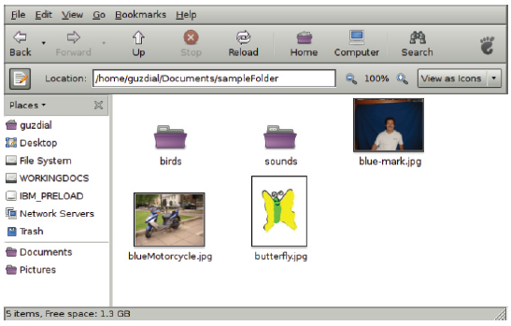
Recursive Directory Traversals
On your disk, there are folders inside of folders.
The folder is made up of folders (and files).
How do we process all files in a folder, including all the subfolders?
Use recursion!

Slide 112
Listing all files, recursively
import os
import java.io.File as File
def printAllFiles(directory ):
files = os.listdir(directory)
for file in files:
fullname = directory+"/"+file
if isDirectory(fullname ):
printAllFiles(fullname)
else:
print fullname
def isDirectory(filename ):
filestatus = File(filename)
return filestatus.isDirectory ()
If the file is a directory, list it just like this directory (recursive call).
If it is not (else), just print the filename

Slide 113
Testing the function
>>> printAllFiles("/home/guzdial/Documents/
sampleFolder")
/home/guzdial/Documents/sampleFolder/
blueMotorcycle.jpg
/home/guzdial/Documents/sampleFolder/sounds/
bassoon -c4.wav
/home/guzdial/Documents/sampleFolder/sounds/
bassoon -g4.wav
/home/guzdial/Documents/sampleFolder/sounds/
bassoon -e4.wav
/home/guzdial/Documents/sampleFolder/birds/bird3.jpg
/home/guzdial/Documents/sampleFolder/birds/bird2.jpg
/home/guzdial/Documents/sampleFolder/birds/bird1.jpg
/home/guzdial/Documents/sampleFolder/birds/bird5.jpg
/home/guzdial/Documents/sampleFolder/birds/bird4.jpg
/home/guzdial/Documents/sampleFolder/birds/bird6.jpg
/home/guzdial/Documents/sampleFolder/blue -mark.jpg
/home/guzdial/Documents/sampleFolder/butterfly.jpg

Slide 114
Recursing, differently
def decreaseRedR(aList ):
if aList == []: # empty
return
setRed(aList [0], getRed(aList [0])*0.8)
decreaseRedR(aList [1:])
This has trouble, in part, because all the list of pixels is being passed in each call.

Slide 115
Store the list in a “Global”
aPicturePixels =[]
def decreaseRedR(aPicture ):
global aPicturePixels
aPicturePixels=getPixels(aPicture)
decreaseRedByIndex(len(aPicturePixels )-1)
def decreaseRedByIndex(index ):
global aPicturePixels
pixel = aPicturePixels[index]
setRed(pixel , 0.8 * getRed(pixel ))
if index == 0: # empty
return
decreaseRedByIndex(index - 1)
aPicturePixels, created outside of any function is “global” – accessible from any function in the file.
Now, only the index number is passed along.

Slide 116
Why use functional programming and recursion?
Can do a lot in very few lines.
Very useful techniques for dealing with hard problems.
ANY kind of loop (FOR, WHILE, and many others) can be implemented with recursion.
It's the most flexible and powerful form of looping.

Slide 117
Questions? Comments?
What did we do today?
What was valuable to you?
What should be expanded?
What should I leave out next time?
What should receive less emphasis?
What do you need me to review next time?
Notes:
Finished chapter 12 12-1-20, 12-2-20, 12-3-20, 12-4-20

